Slide 1
Evolution, Religion, & Nature of Science

Slide 2
Cultural Competence
Take two minutes and define the following term on your worksheet: Cultural competence
The ability of people of one ​
culture to understand, communicate, operate, ​
and provide effective services to help people of ​
another culture.

Slide 3
What is evolution?
Take two minutes and answer the above question: What is evolution?
Change in allele frequency through time
Notes:
This definition, although technical in nature, may not be seen as controversial. This is the definition used in population genetics, which is a suite of tools that can be used to study what some people call “micro”-evolution. However, this definition applies to much more than the evolution of populations. For example…

Slide 4
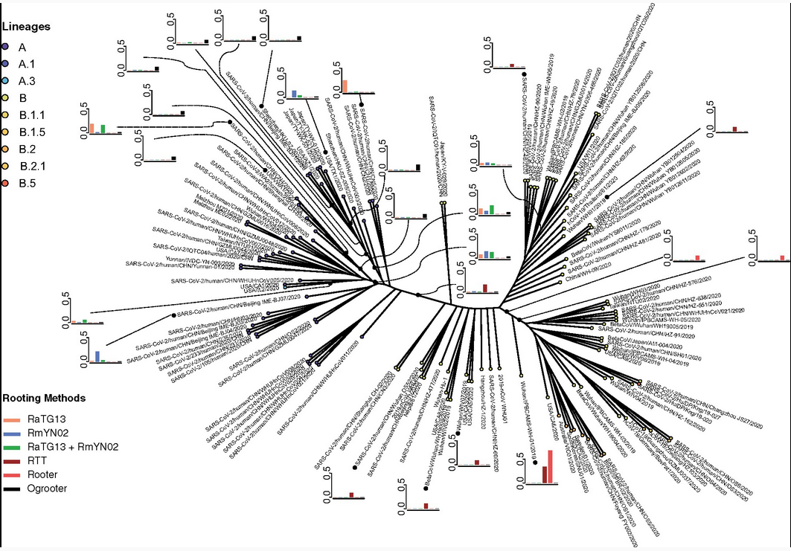
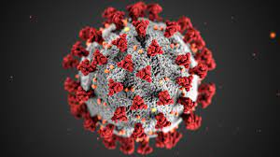
Pipes et al., 2021
Notes:
Change in allele frequency through time is what differentiates strains of SARS-COV-2

Slide 5
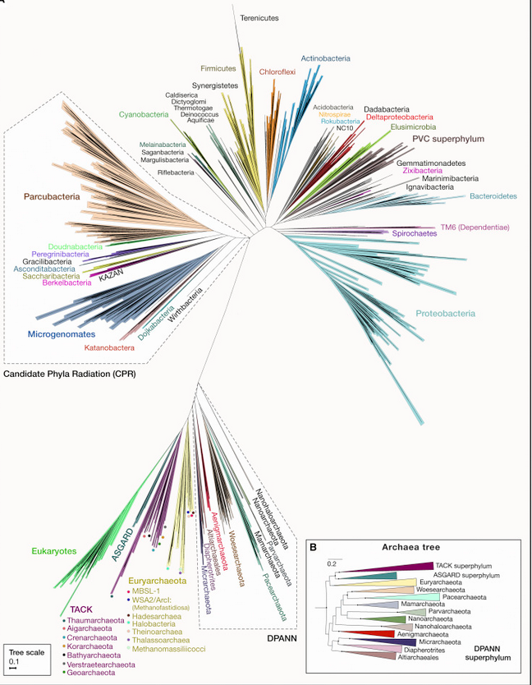
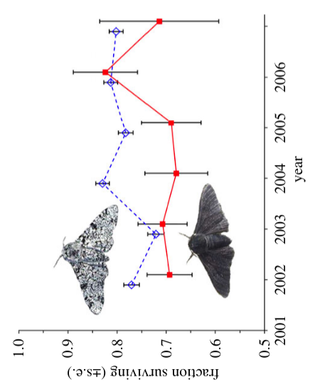
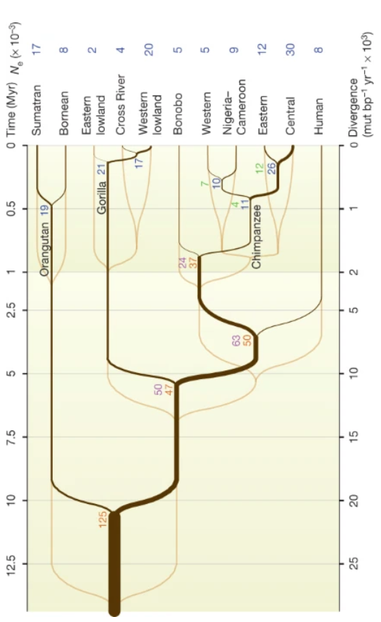
Cook et al., 2012
Prado-Martinez et al., 2013
Castelle & Banfield, 2020
Notes:
Changes in allele frequency are sometimes driven by natural forces, a process known as natural selection (example: peppered moths). Changes in allele frequency can help us understand our (humans) relationship to other great apes and look backwards in geological time to understand when we diverged from each other. And finally, changes in allele frequency can help us understand our common ancestry with all life on earth. *NOTE: This last phylogeny doesn’t include viruses, whose relationship with bacteria/eukarya/archaea is not known.

Slide 6
What is evolution?
Descent (with modification) of all living
Beings from a common ancestor.
Notes:
Therefore, another definition that we can use is this. Although the first definition can be used to explain descent with modification and common ancestry, this principle (sometimes referred to as “macro”-evolution when looking at species [or deeper] relationships) may be more controversial…

Slide 7
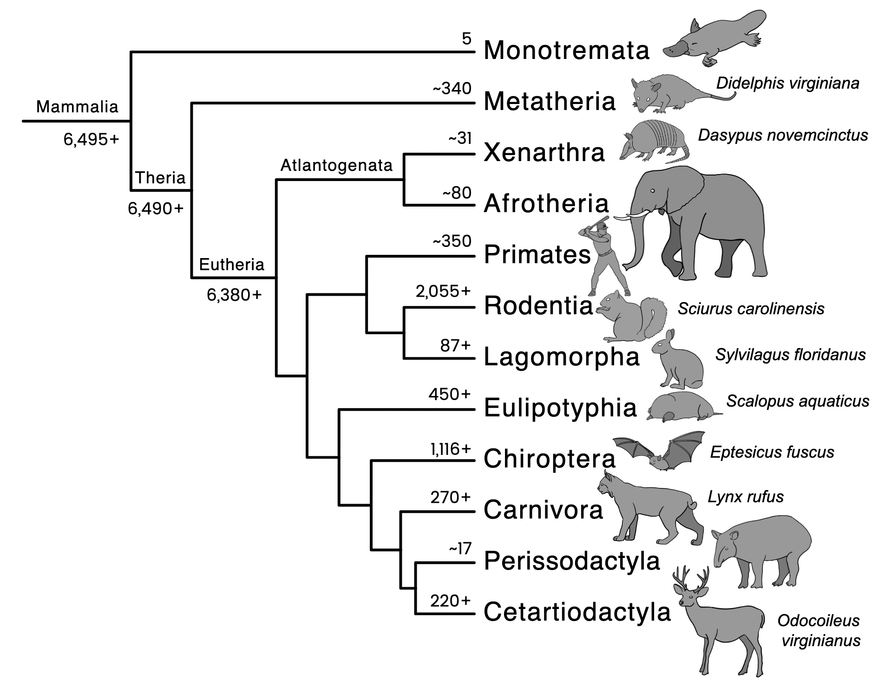
Is evolution controversial?
Why / Why not?
Discuss with your group and record your answer on your handout.
Notes:
Have students discuss if evolution is controversial in small groups. Then have them discuss why/why not in the same small groups.

Slide 8
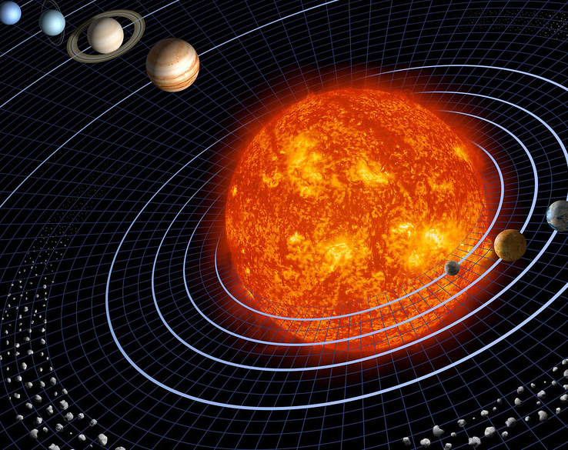
Is heliocentrism controversial?
Why / Why not? Discuss with your group and record your answer.
“scientifically unproven and unfounded”
Directly contradicted religious doctrine
& interpreted scripture
Removed necessity of God
“How could the earth hang suspended in the air were it not upheld by God’s hand?”
Notes:
Ask class if heliocentrism is controversial (explain that heliocentric theory is the fact that the bodies of our solar system revolve around the sun). Although this idea is not controversial (with the exception of some fringe theories on youtube), historically it was considered [read slide]. The instructor can describe further the history of Heliocentrism (https://en.wikipedia.org/wiki/Heliocentrism), including the description by Nicola Copernicus and its reception in early modern Europe.

Slide 9
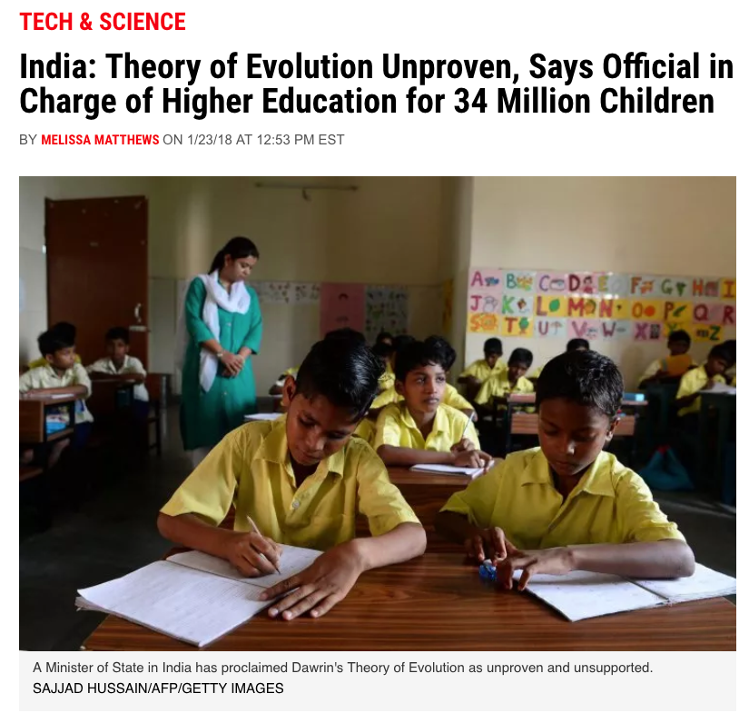
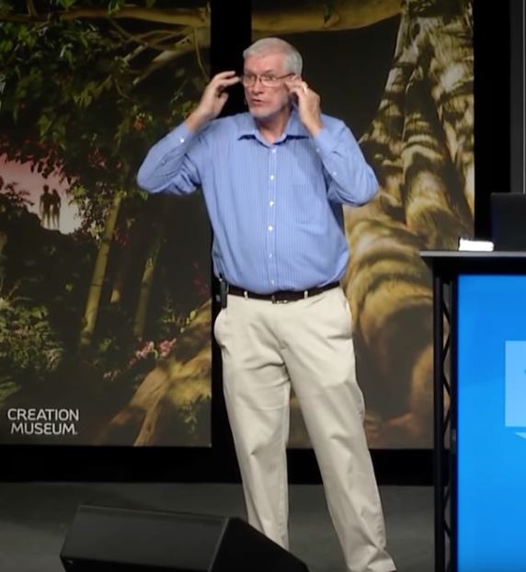
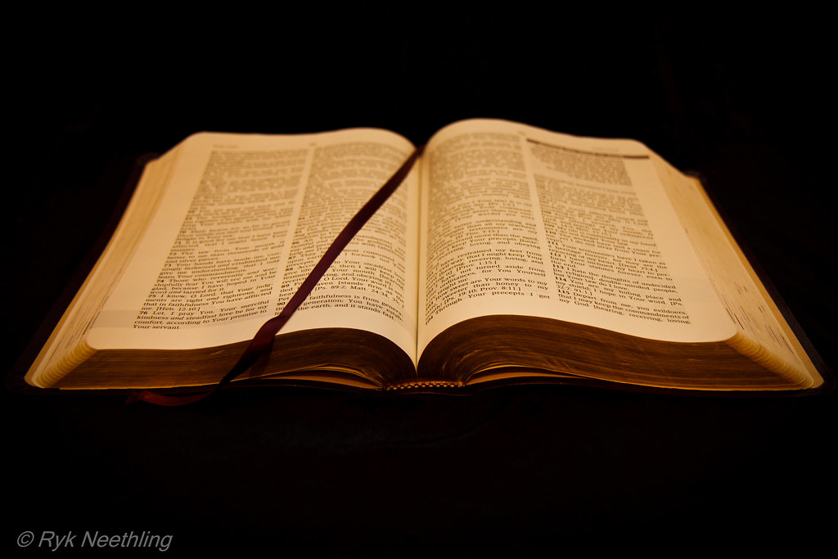
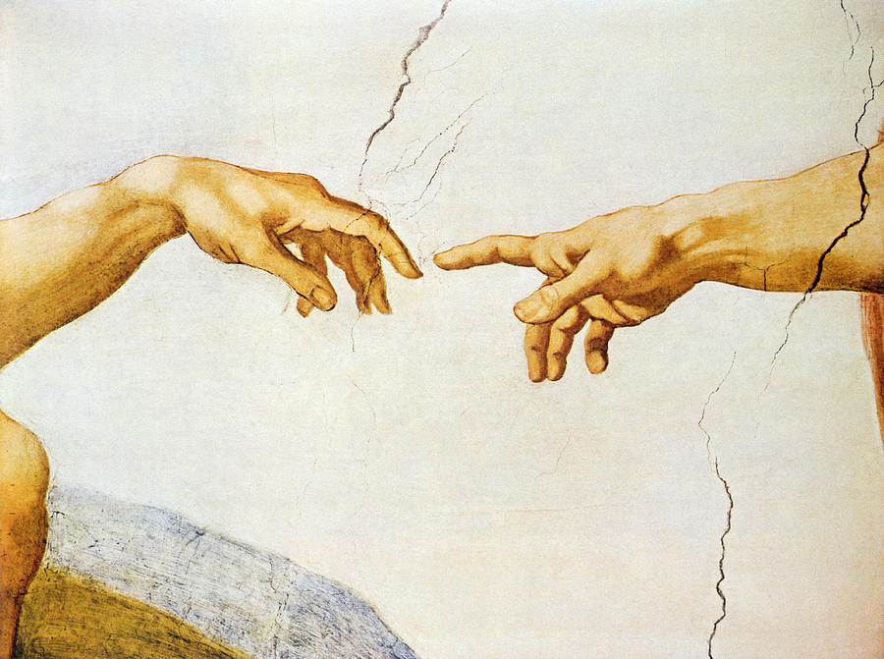
Notes:
Explain that evolution faces similar criticism today, including (1) claims that evolution is unproven, (2) claims that it contradicts scripture [photo of Ken Ham, a prominent theologian and young earth creationist that opposes evolution], and (3) the notion that it removes the necessity of God from society. Many of these issues stem from an underlying belief that evolution and religion cannot co-exist.

Slide 10
Can evolution and religion co-exist?
Take 5 minutes to discuss with your groups and record your answer on your handout.
To address this question, we will first examine the nature and limitations of science.
Notes:
The question at the top bar is rhetorical- students will answer it after activities that are focused on helping them understand the nature of science.

Slide 11
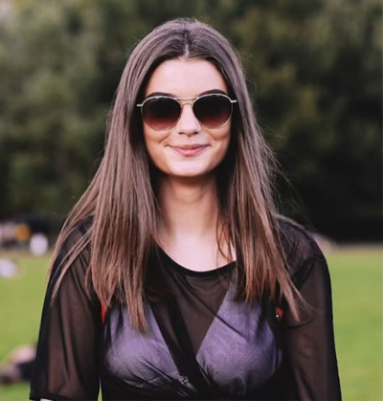
Notes:
Ask students: “What color is this person's shirt?” Then ask: “Are this person’s eyes open?” Students should identify that they cannot know.

Slide 12

Notes:
Ask students “Are this person’s eyes open?”

Slide 13
Notes:
Point out that an infrared lens was used for the second photo. Different lenses allow us to perform differential interpretation of the world around us. In science, we use a lens that gathers facts and uses evidence to make inferences about the natural world. Because of this, science is limited to observations that can be made within the boundaries of the natural world.
Following this remark, pause for students to record their answers on the worksheet for the question: "How does this example relate to the Nature of Science and the relationship between religion and science?

Slide 14
Nature of Science
Take the next 15 minutes to discuss the following scenarios with your group and record your answers on your worksheet. For each scenario, answer whether the phenomenon be explained using scientific inquiry:
Sudden drop in temperature indicates the presence of a ghost
Green plants grow towards a light source
Sponges filter bacteria out of the water on coral reefs
Pele, the goddess of fire, inflicts a curse on those who remove lava rock from the Hawaiian Islands.
Crop circles are caused by extraterrestrial life forms
Notes:
Ask students afterwards:
How did you decide whether the claim could be investigated through science?
If a claim cannot be investigated through the practices of science, does that mean that the claim is false?
Explain that there are many approaches to explaining phenomena (scientific, historical, political, religious, economic, philosophical, etc.). In this science class, we will be exploring and constructing scientific explanations which are supported by scientific evidence and scientific reasoning. Science gathers observations to understand the natural world, and therefore cannot make inferences regarding the supernatural. Likewise, supernatural explanations should not be used to explain natural phenomena (since they can not be tested scientifically).

Slide 15
Can evolution and religion co-exist?
After examining the nature and limitations of science, what is your answer for this question?
Notes:
Before looking at quotes from religious figure heads and scientists, students reflect on their own thoughts given their new knowledge.

Slide 16
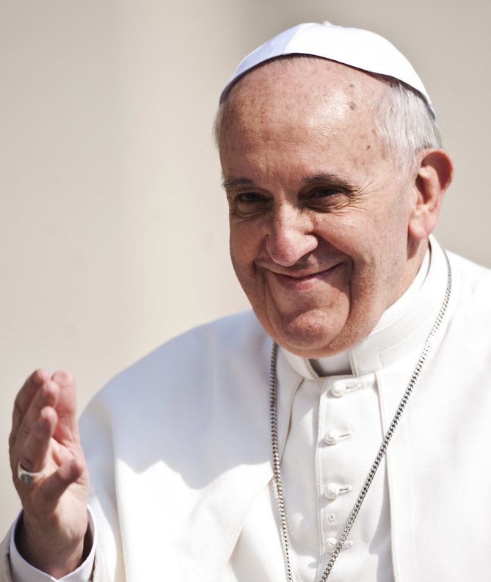
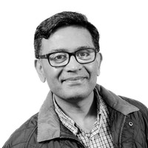
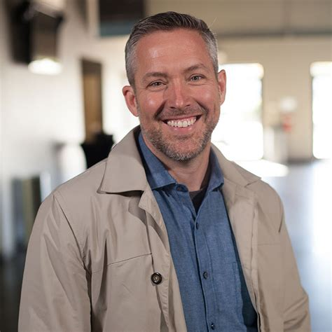
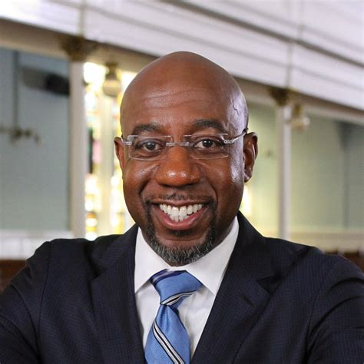
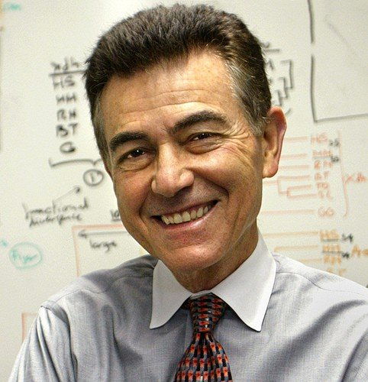
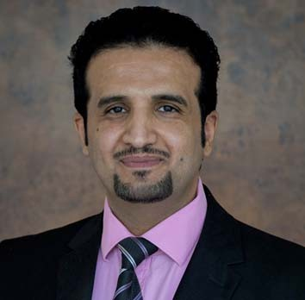
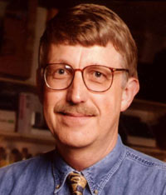
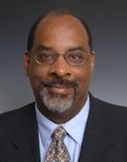
Catholic
White Evangelical Protestant
Muslim
Black Protestant
Religious Leader
Pope Francis
Khalid Anis
Denis O. Lamoureux
Raphael Warnock
Head of Catholic Church
Executive Director:
Islamic Society of Britain
President:
Southern Baptist Convention
Senior Pastor
Ebenezer Baptist Church
Scientist
Francisco Ayala
Mohammed Alassiri
Francis Collins
Joseph Graves
Professor of Biology
UC- Irvine
Professor of Physiology
King Saud bin Abdulaziz Univ
Director: National Human Genome Research Institute
Professor of Biology
NC Ag and Tech State Univ
Notes:
Introduce religious leaders and scientists who recognize the ability for coexistence between science and religion. The quotes on the following slides do not all need to be used- rather instructors can use those they see most fit for their classrooms.

Slide 17
Catholic
“Evolution in nature is not inconsistent with the notion of creation, because evolution requires the creation of beings that evolve.”
Religious Leader
Pope Francis
Head of Catholic Church
Scientist
"My conviction is that the theory of evolution is theology's disguised friend, not its enemy."
Francisco Ayala
Professor of Biology
UC- Irvine

Slide 18
Muslim
“The theory of evolution was a ground-breaking scientific development which led to many religious groups and denominations reforming the way they discussed and thought about the origin of mankind.”
Religious Leader
Khalid Anis
Executive Director:
Islamic Society of Britain
“Evolution is the disguised friend of Islam. Religion is the source of theological, moral and spiritual values, whereas science is the source of innovation, discovery and improved quality of life.”
Scientist
Professor of Physiology
King Saud bin Abdulaziz Univ

Slide 19
White Evangelical Protestant
“Can you be a Christian and believe in evolution and not have it show something significantly wrong with your faith? The answer is yes.”
Religious Leader
J.D. Greear
President:
Southern Baptist Convention
“Evolution, as a mechanism, can be and must be true. But that says nothing about the nature of its author. For those who believe in God, there are reasons now to be more in awe, not less.”
Scientist
Francis Collins
Director: National Human Genome Research Institute

Slide 20
Black Protestant
“My faith has no quarrel with science.”
Religious Leader
Raphael Warnock
Senior Pastor
Ebenezer Baptist Church
“It took me to become far more mature, both in my science and in my theology to understand that the two did not have to be in conflict with each other. Now I understand scripture to be symbolic and hence, since it was never meant to be a text in natural history, there’s no reason to hold the two against each other.”
Scientist
Joseph Graves
Professor of Biology
NC Ag and Tech State Univ

